Slide 1



Boba Phone Bank

Slide 2
Boba Phone Bank

Slide 3
Boba Phone Bank

Slide 4
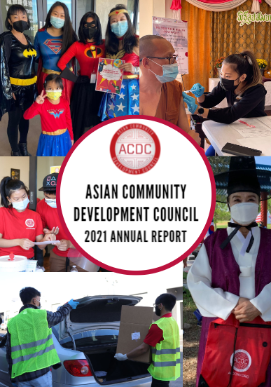

Slide 5
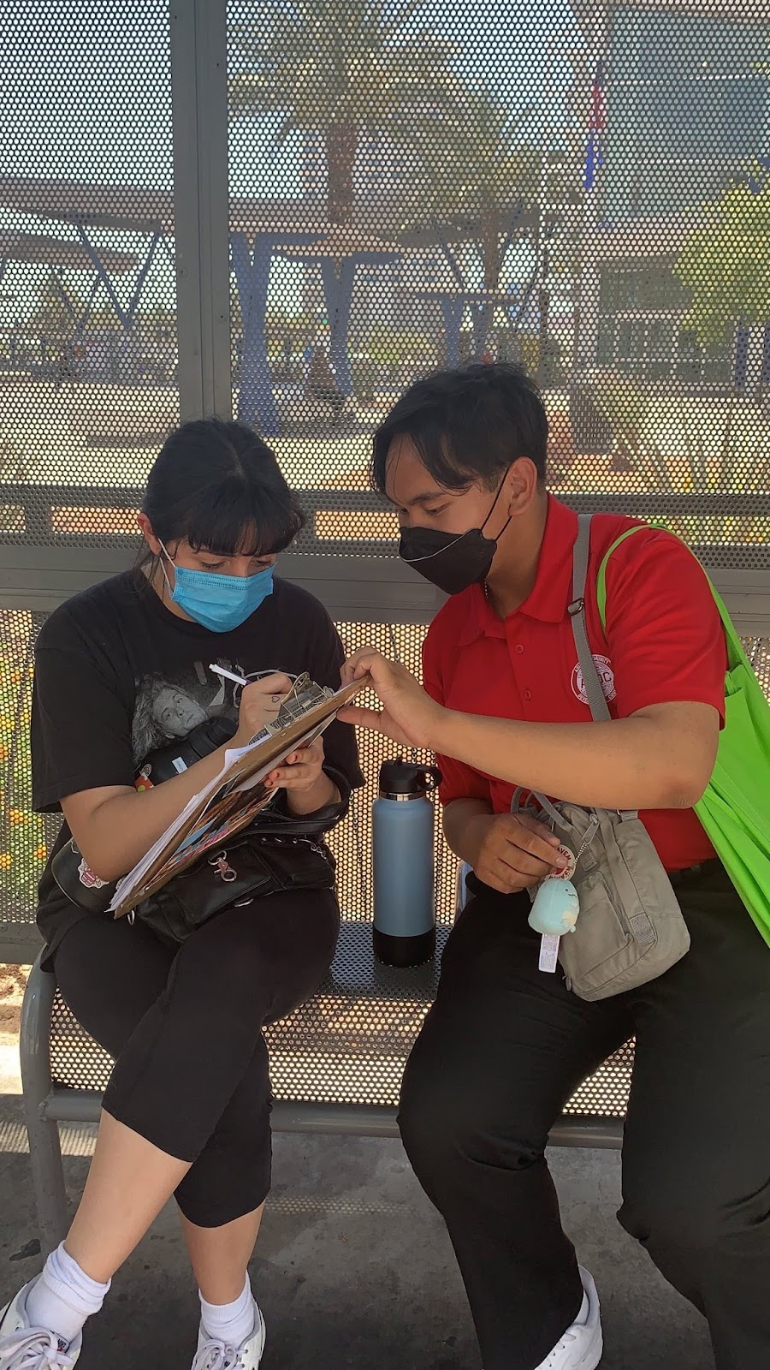
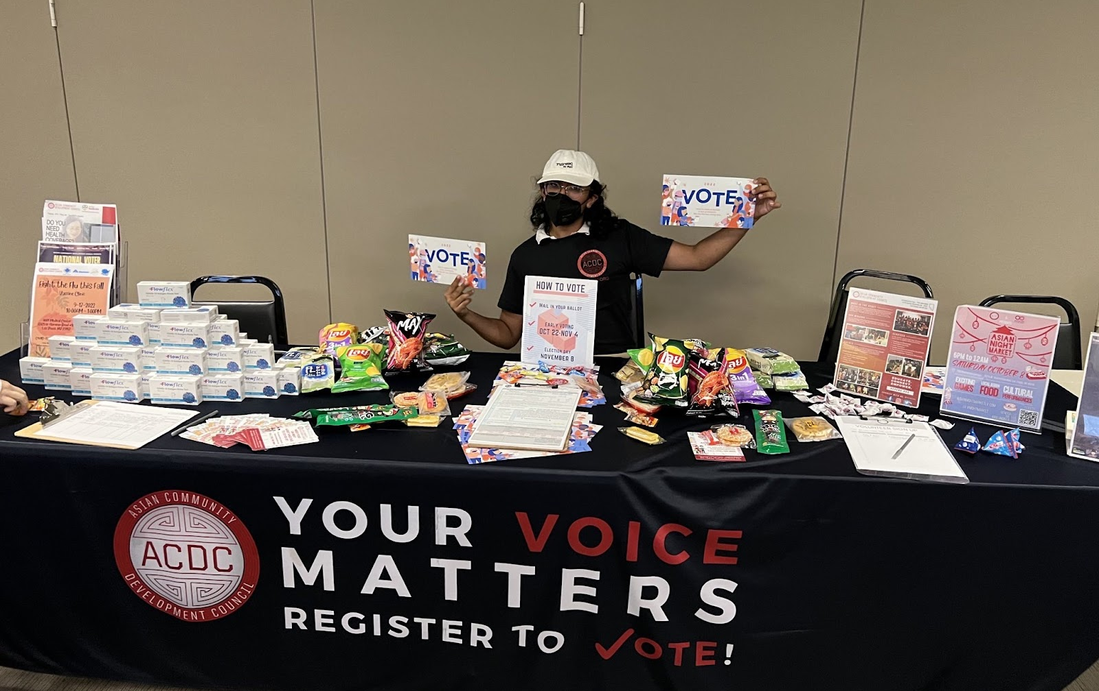
Who We Are
- Asian Community Development Council (ACDC NV)
501 (c)(3) nonpartisan, nonprofit organization
- Our Mission
Educate, connect and empower the Asian and Pacific Islander Community in Nevada
ACDC Outreach Team
- Voter Registration
- Get Out to Vote
- Chinese Voter Guide
Teamed with All Voting is Local
Missed threshold by 500 people

Slide 6
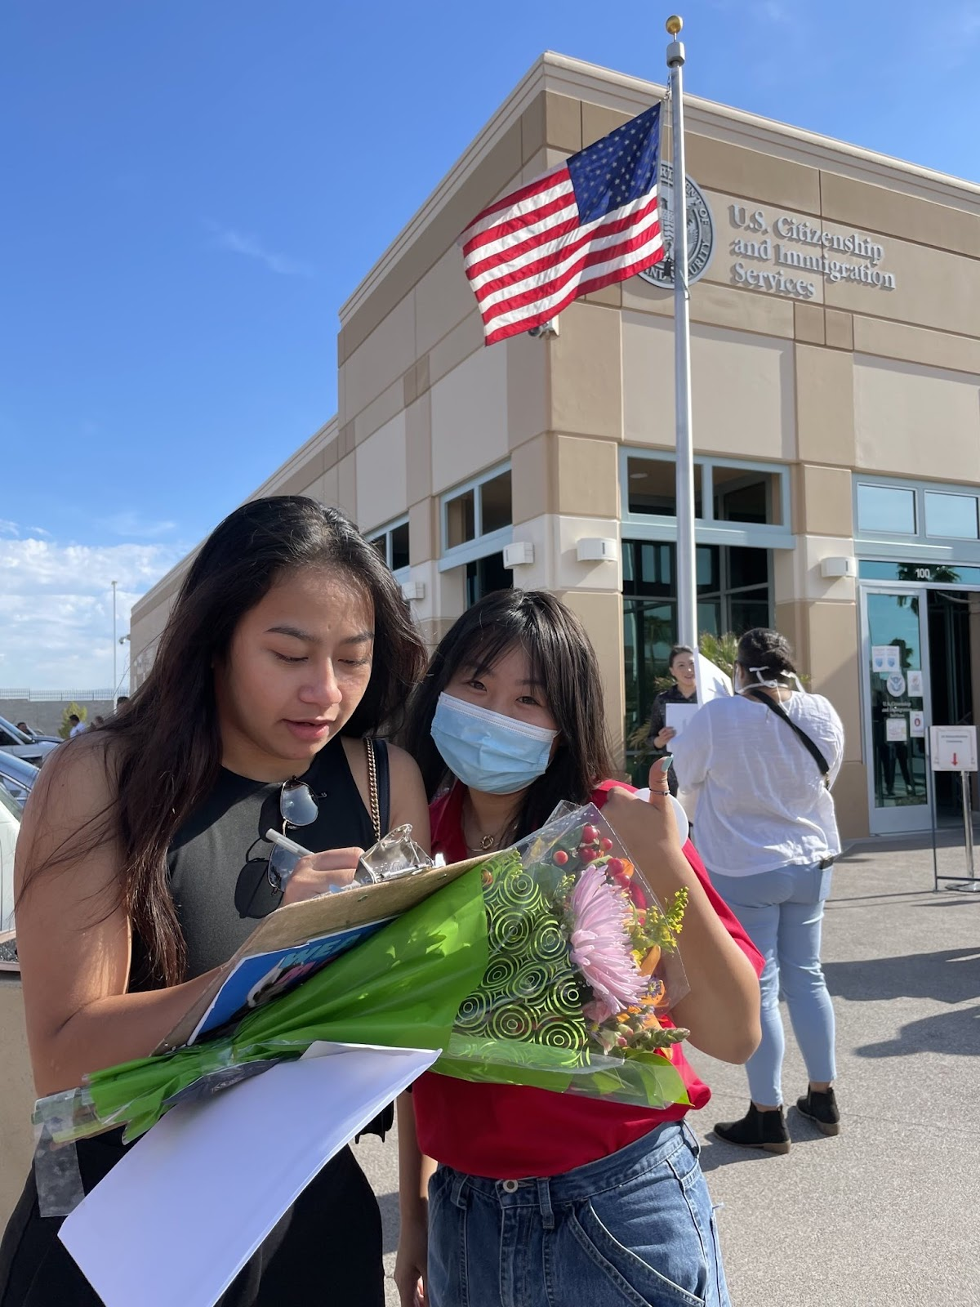
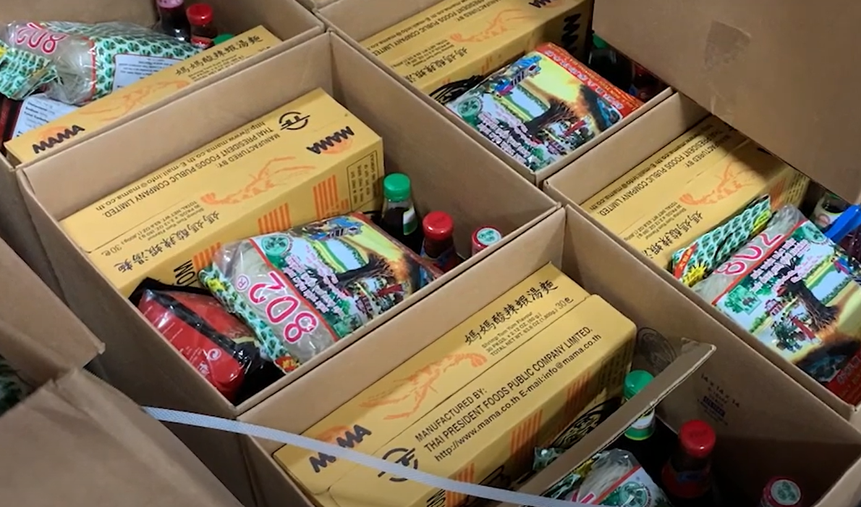
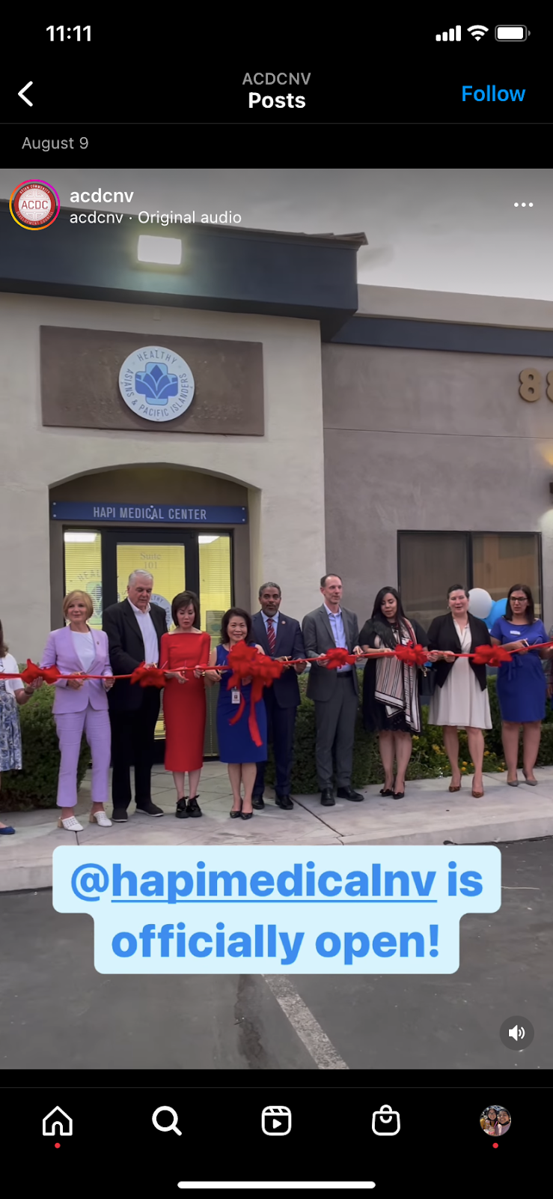
Who We Are
- Asian Community Development Council (ACDC NV)
501 (c)(3) nonpartisan, nonprofit organization
- Our Mission
Educate, connect and empower the Asian and Pacific Islander Community in Nevada
Application
translation, waiver applications
Citizenship Assistance
ACDC Outreach Team
The Rest of Our
ACDC Team
Food Distribution
Tailored To Our Community’s Diet
- Voter Registration
- Get Out to Vote
- Chinese Voter Guide
Teamed with All Voting is Local
Missed threshold by 500 people
Health insurance, vaccine pop-ups, in language assistance
HAPI Clinic

Slide 7

Now For Our Phone Bank:
ACDC Outreach Team
The Rest of Our
ACDC Team
- Voter Registration
- Get Out to Vote
- Chinese Voter Guide
Teamed with All Voting is Local
Missed threshold by 500 people
Food Distribution
Tailored To Our Community’s Diet
HAPI Clinic
Citizenship Assistance
Health insurance, vaccine pop-ups, in language assistance
Application
translation, waiver applications

Slide 8
The Rest of Our
ACDC Team
Now For Our Phone Bank:
Food Distribution
Tailored To Our Community’s Diet
HAPI Clinic
Citizenship Assistance
Health insurance, vaccine pop-ups, in language assistance
Application
translation, waiver applications
Wifi: ACDC – Guest
Password: welcomeACDC
Website:
thrutalk.io/caller/login/ssvnv

Slide 9
Now For Our Phone Bank:
Wifi: ACDC – Guest
Password: welcomeACDC
Website:
thrutalk.io/caller/login/ssvnv

